Slide 1


AstroSage
Analysis
SHUBHAM SINGH

Slide 2
Problem Statement
Astrosage has received a 1 crore investment and aims to optimize its call center operations. The goal is to determine how to allocate this investment to maximize operational efficiency, customer satisfaction, and profitability. The analysis will consider historical call data, performance metrics, and market trends to make informed decisions.

Slide 3

About Astrosage
Trusted online astrology platform designed to provide clarity and confidence in life’s journey.
Dedicated to making astrology accessible to everyone with meaningful insights into life, relationships, and career.
Offers direct connections with experienced astrologers via live chat, call, or video consultations.
Provides a variety of personalized services, including horoscope readings, Vedic astrology, and numerology.
Focuses on delivering tailored guidance to meet the unique needs of every individual.

Slide 4
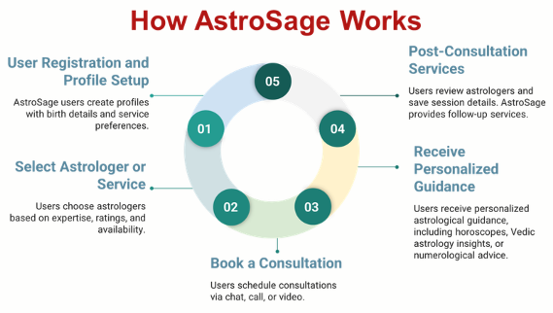

Slide 5

Data Overview
Key Performance Indicators (KPIs)
Total Consultations: 28,027
Total Revenue: ₹2,13,987
Average Rating: 3.69 / 5
Investment: ₹1 crore allocated for operational optimization
Data Cleaning and Preprocessing
Attribute Removal: Removed non-informative columns.
Data Consistency: Standardized guruName formatting.
Data Cleaning: Removed unwanted characters and handled missing values optimization.
Data Utilization
Analyzed customer engagement patterns
Evaluated guru performance and ratings
Identified operational inefficiencies
Generated insights for strategic investment allocation

Slide 6
Website Traffic Source
Key Insights:
App has highest traffic.
Gurucool traffic is comparatively lower.
Dashboard traffic is minimal.
Recommendation:
Improve Gurucool and dashboard user engagement through
promotional campaigns and better UI experience.

Slide 7
Revenue by Consultation Type
Key Insights:
Calls generate highest revenue.
Chat consultations have lower monetization despite high activity.
Recommendation:
Improve chat monetization through premium consultation features and upselling strategies.

Slide 8
Consultation Success Rate
Key Insights:
Large number of consultations remain incomplete or failed.
Operational inefficiencies affect customer experience.
Recommendation:
Improve queue management and callback systems to increase successful consultations.

Slide 9
Call Distribution Over Hours
Key Insights:
Peak traffic occurs between morning and afternoon hours.
Certain hours experience heavy consultation load.
Recommendation:
Deploy more agents during peak hours for better workload balancing.

Slide 10
Top Performing Gurus
Key Insights:
Few gurus maintain significantly higher ratings.
Performance gap exists among gurus.
Recommendation:
Provide mentorship and targeted training for lower-performing gurus.

Slide 11
Daily Consultation Volume
Key Insights:
Daily consultation volume fluctuates significantly.
Certain days show traffic decline.
Recommendation:
Use promotional offers during low-traffic periods to stabilize consultation volume.

Slide 12
Call & Chat Status
Key Insights:
Completed interactions dominate overall status distribution.
Busy status still impacts customer satisfaction.
Recommendation:
Improve agent availability and automate initial support handling.

Slide 13
USER RATING DISTRIBUTION
Key Insights:
Most users fall within average rating range.
Very high ratings are limited.
Recommendation:
Improve first-response quality and customer handling experience.

Slide 14
Guru Rating Distribution
Insight:
Guru performance distribution is uneven.
Only few gurus maintain consistently high ratings.
Recommendation:
Introduce performance-based incentives and skill development programs.

Slide 15

Strategic Recommendations
Recommendation: Implement advanced call tech, use predictive algorithms for traffic.
Reason: Imbalanced call handling, agent burnout, and inconsistent service.
Expected Impact: Improved efficiency, faster responses, better customer satisfaction.

Slide 16

Enhancing Customer Interactions Through Targeted Training
Recommendation:
Invest in targeted training programs.
Incorporate real-time feedback tools.
Reason:
Analysis shows high chat activity but low revenue.
Expected Impact:
Higher revenue through improved conversions.
Increased customer loyalty through personalized and empathetic interactions.

Slide 17
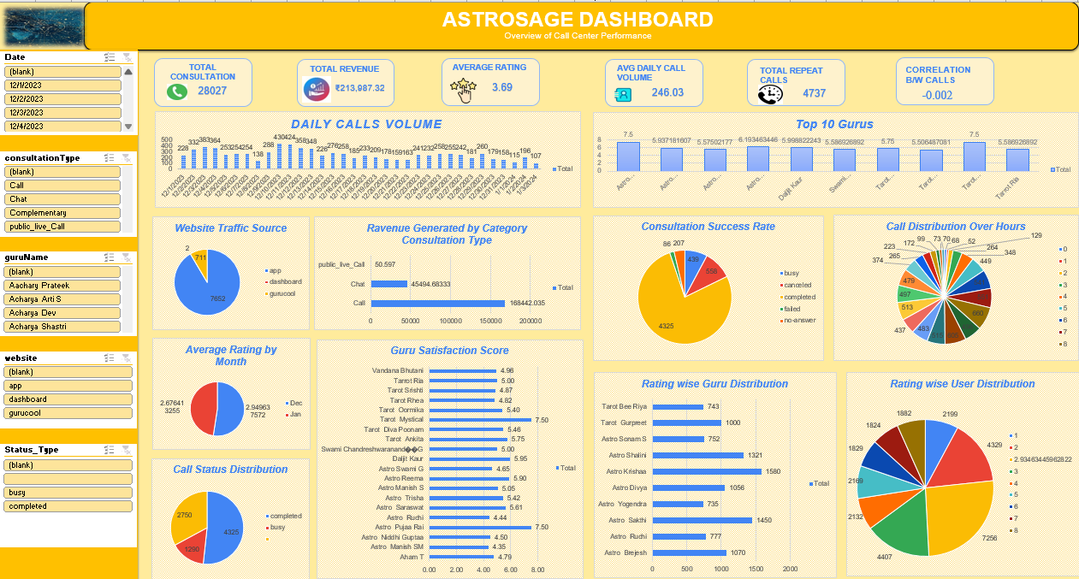

Slide 18

Optimizing Customer Service Technology
Recommendation:
Upgrade call center tech for real-time solutions.
Use AI chatbots for initial triaging.
Optimize CRM tools for better query management.
Reason:
Chat activity-revenue gap is significant.
Expected Impact:
Boost market share via scalable services.
Improve customer experience with faster resolutions.

Slide 19

Conclusion
Key Findings:
High chat activity, low revenue.
Uneven workload distribution.
Training gaps.
Implications:
Operational Efficiency: Optimize technology and balance workload.
Revenue Growth: Improve agent training and upgrade technology.
Customer Satisfaction: Invest in technology and training.
Closing Statement:
Implementing these recommendations will improve AstroSage's efficiency, customer satisfaction, and market competitiveness.

